Slide 1
Black Magic
Brad Bensch, Kevin Mulligan, Chad Koppes, Jenny Zhen, William Spaw
Notes:
Bill

Slide 2
Agenda
Introduction
Agenda
Design Overview
Implemented Patterns
Functionality
Demo
Questions
Notes:
Bill

Slide 3
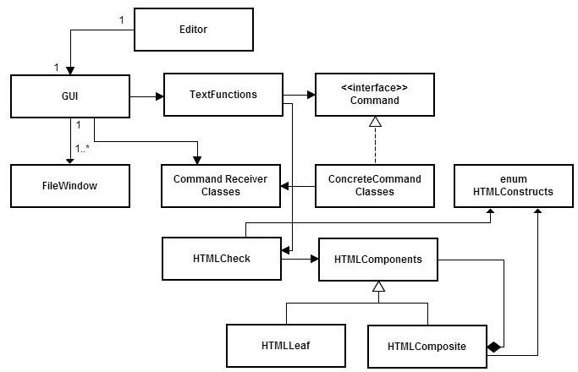
Design Overview
<UML>
</UML>
Notes:
Chad

Slide 4
Design Overview
Evolution of the design
Built out from central GUI
Command Pattern handles GUI functionality
Composite Pattern handles HTML
Good Cohesion and Separation of Concerns
Notes:
Chad

Slide 5
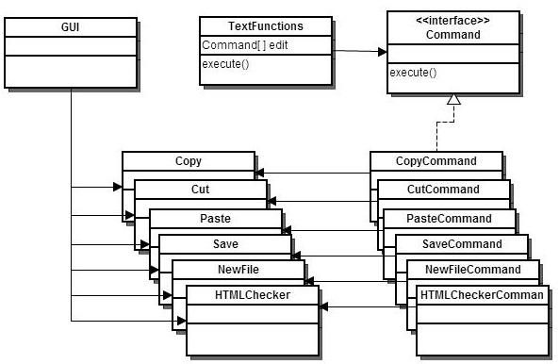
Implemented Patterns
Command
Notes:
Bensch

Slide 6
Implemented Patterns
Command
Good for GUI Buttons/Actions/Events
Eventual Undo ability
Easy to add additional functionality with new Commands
Tradeoff: Size; many little classes
Notes:
Bensch

Slide 7
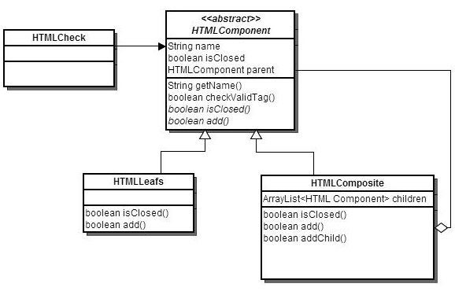
Implemented Patterns
Composite
Notes:
Jenny

Slide 8
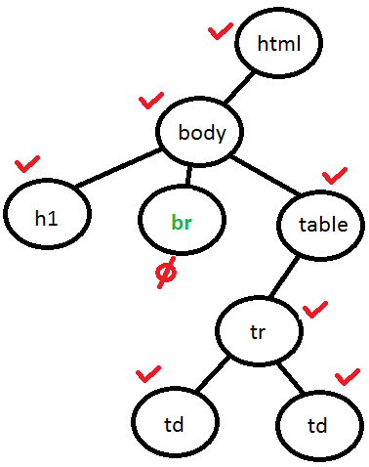
Implemented Patterns
<html>
<body>
<h1>Text</h1>
<br>
<table>
<tr>
<td>Text</td>
<td>Text</td>
</tr>
</table>
</body>
</html>
Notes:
Jenny

Slide 9
Implemented Patterns
Composite
Good for keeping track of opening and closing tags.
Tree formed from these nodes is traversed for the HTMLCheck.
Benefit: treat all individual and composite nodes uniformly.
Tradeoff: safety of the program, i.e. add to leaf node
Consequence: easy to add new basic components, i.e. new leaf node class
Notes:
Jenny

Slide 10
Functionality
Started, but not finished:
Indenting
Automatic indenting
User control over indent amount
Not implemented:
Select number of items when inserting list
Command line argument starting file
Check HTML structure on file open
Enable/disable word wrap
Notes:
Kevin

Slide 11
Functionality
These things didn't blow up:
View and edit multiple files
Insert HTML tags from a list
Check for well formed HTML
Multiple ways to execute commands:
Drop-down menu, icon, and control character for:
Open, Save, New, Cut, Copy, Paste
Browse file system for save and open
Option to change file name when saving
Check open documents on program exit
Word wrap
Notes:
End on positive note

Slide 12
Demo

Slide 13
Questions?

